Slide 1



MDP: Markov decision process

Slide 2
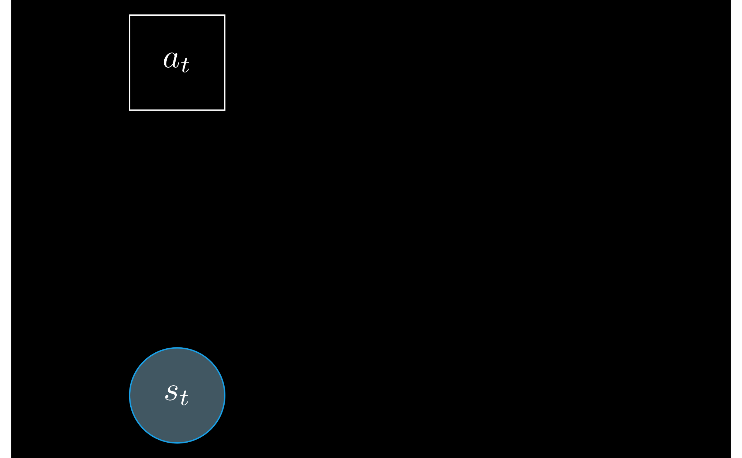
MDP: Markov decision process

Slide 3
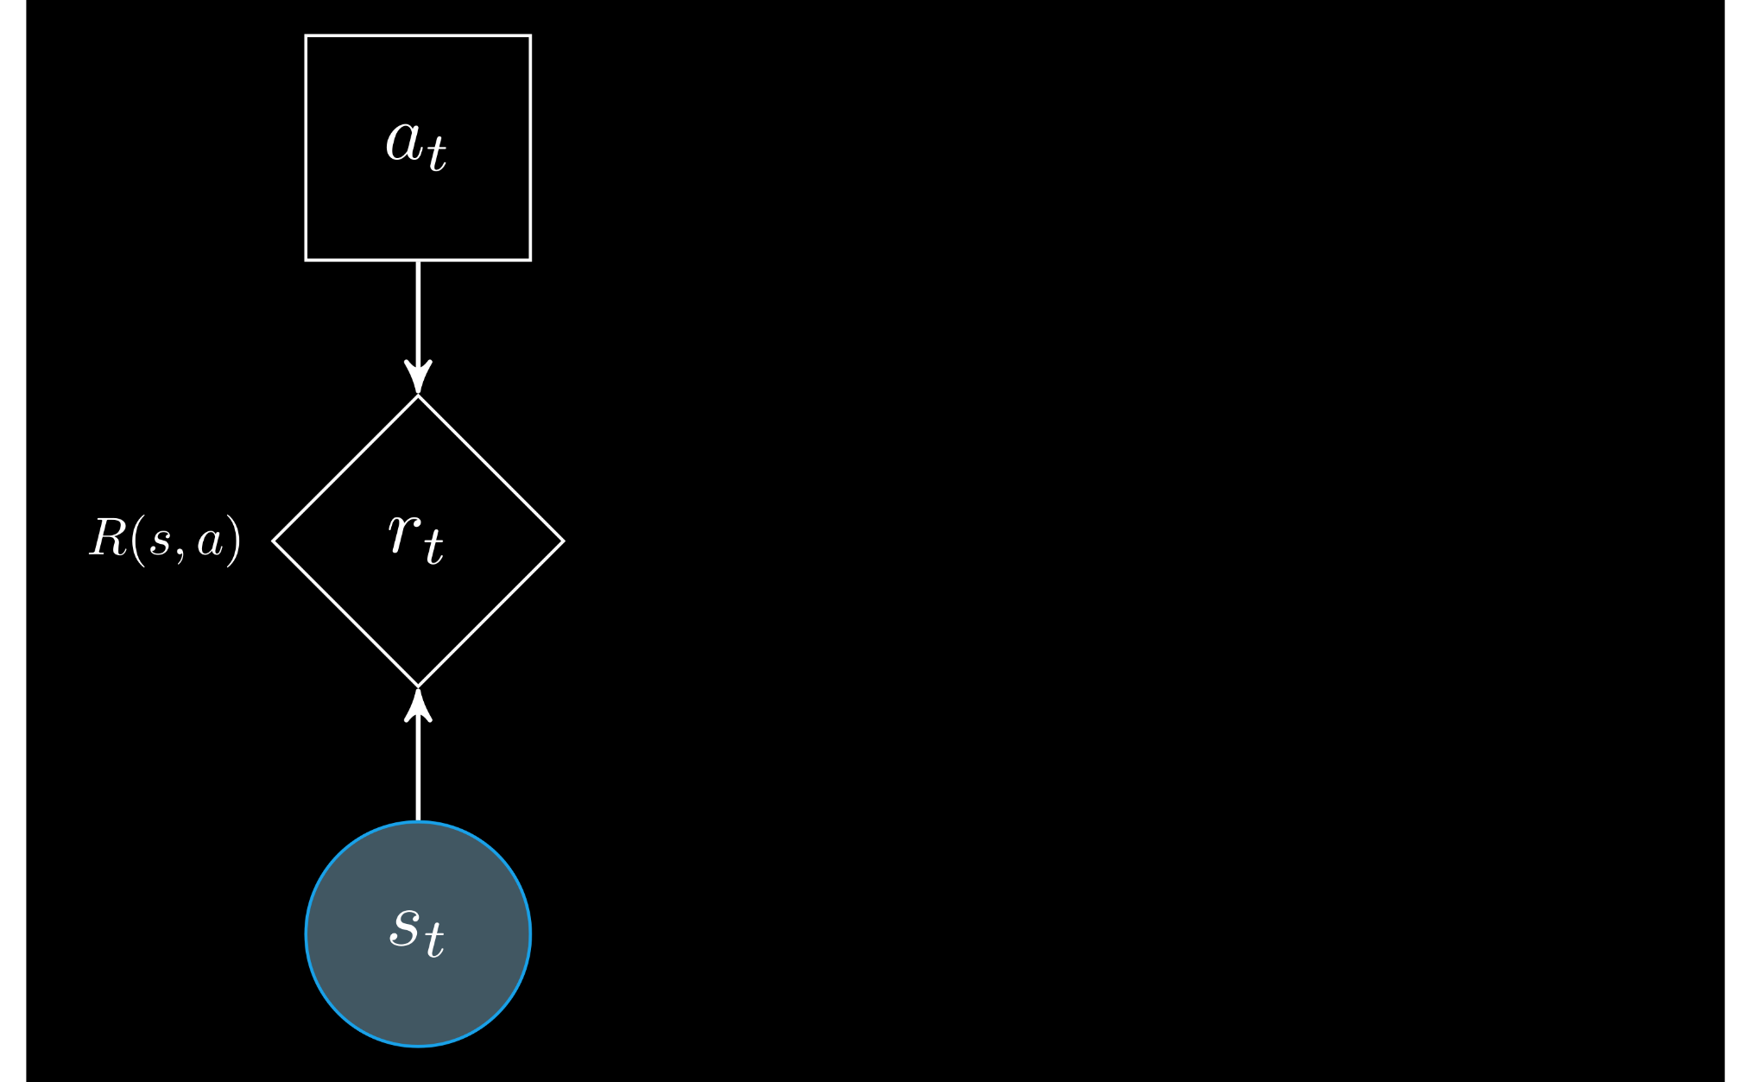
MDP: Markov decision process

Slide 4
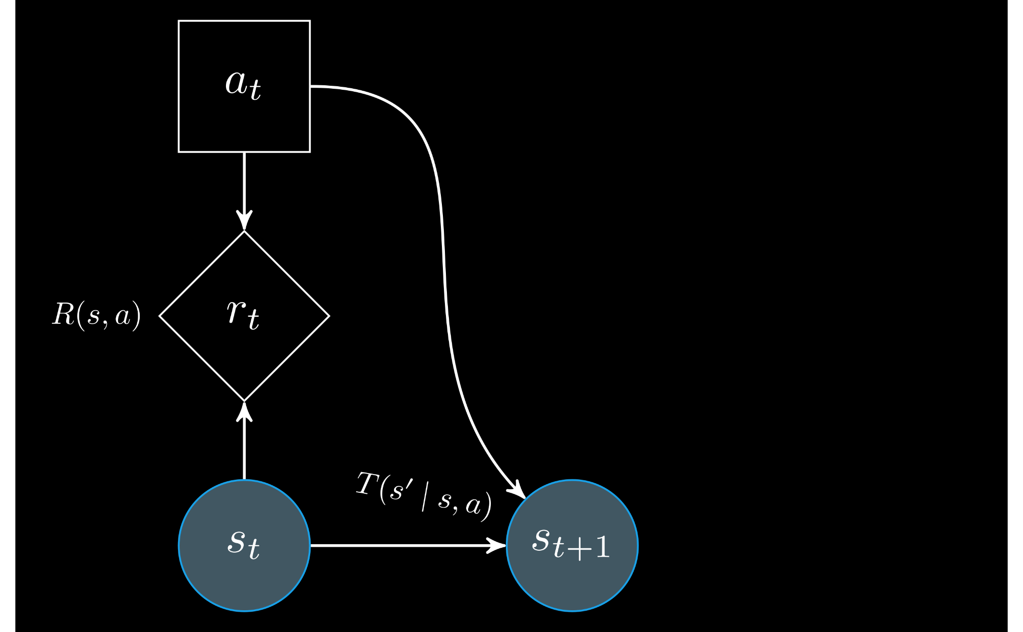
MDP: Markov decision process

Slide 5
MDP: Markov decision process

Slide 6

MDP: Markov decision process

Slide 7

MDP: Markov decision process

Slide 8
Real-world problem: True states are unobservable!

Slide 9

POMDP: Partially observable Markov decision process
Real-world problem: True states are unobservable!

Slide 10

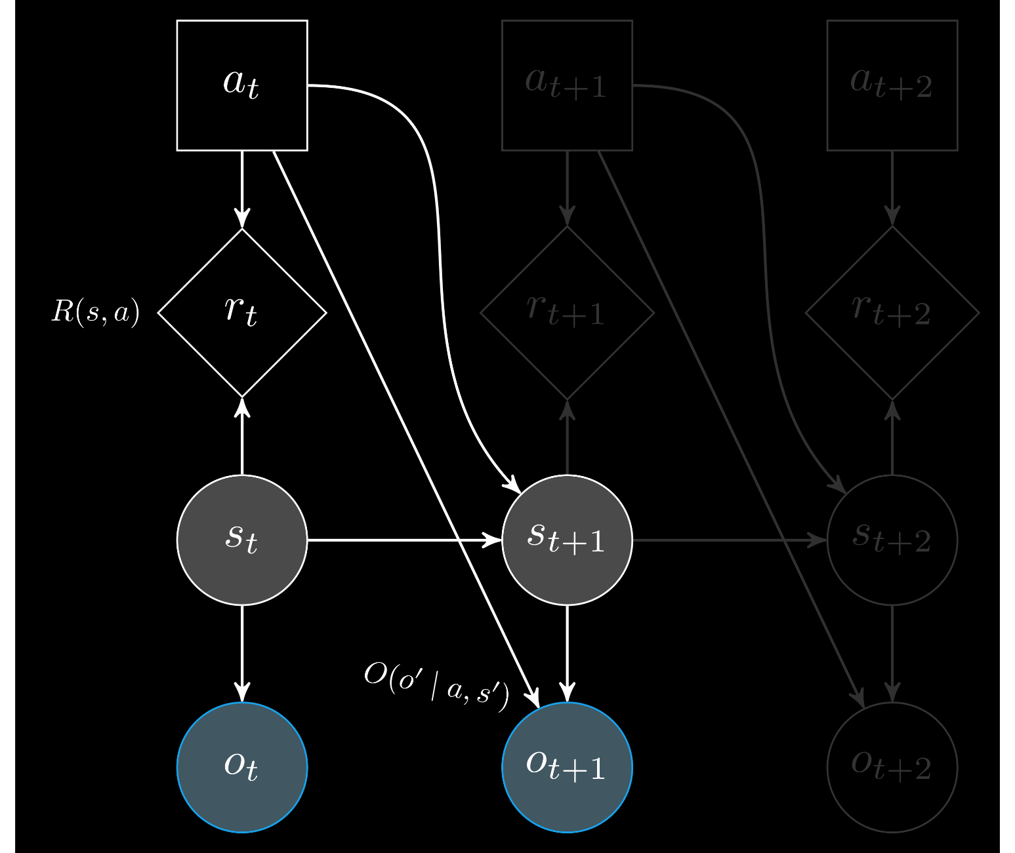
POMDP: Partially observable Markov decision process

Slide 11


State uncertainty: Beliefs

Slide 12


State uncertainty: Beliefs

Slide 13
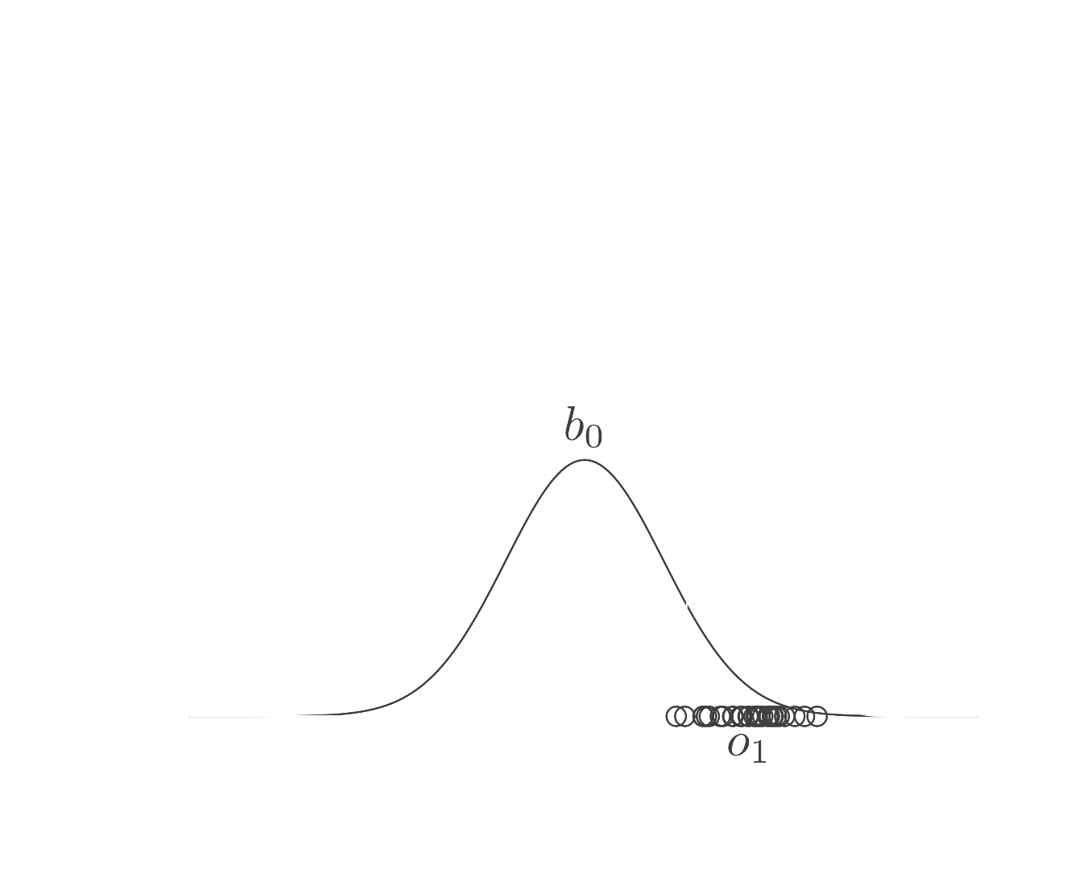
State uncertainty: Beliefs

Slide 14

A policy π maps beliefs to actions
a = π(b)
Solution: Find a policy
Goal: Take the best action from a given belief

Slide 15
Solution: Find a policy
A policy π maps beliefs to actions
a = π(b)

Slide 16

Objective: Maximize rewards
Find an action that maximizes reward

Slide 17
Objective: Maximize rewards
Find a policy that maximizes reward

Slide 18
Objective: Maximize rewards
Find a policy that maximizes reward

Slide 19
Objective: Maximize rewards
Find a policy that maximizes discounted reward

Slide 20
Objective: Maximize rewards
Find a policy that maximizes discounted future reward

Slide 21
Objective: Maximize rewards
Find a policy that maximizes expected discounted future reward

Slide 22
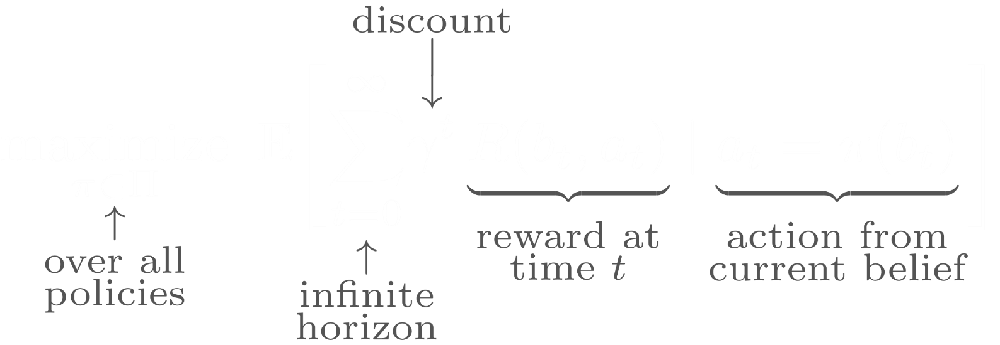
Objective: Maximize rewards
Find a policy that maximizes expected discounted future reward

Slide 23

Solution algorithms
Find the optimal policy π
that maps beliefs to actions

Slide 24
Focus of this lesson: State uncertainty
How do we estimate the belief?

